Slide 1
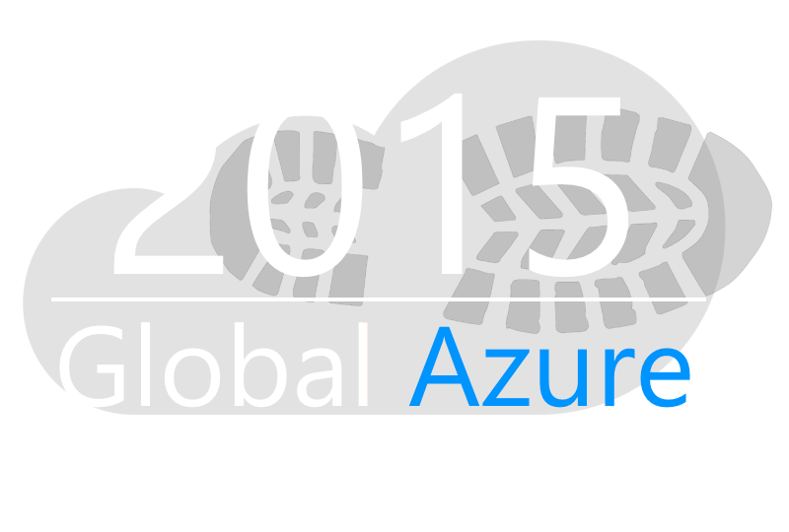

Automating Azure VMs with PowerShell
Feschenko Alexander
Senior Software Engineer @ EPAM Systems
Blog: feschenkoalex.blogspot.com
Email: feschenko.alex@gmail.com

Slide 2
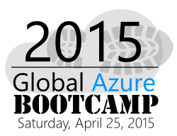
Agenda
1
Intro to Windows Azure PowerShell
Automating Azure virtual machines. Base cmdlets description
2
Demo Session. Create and configure virtual machine. Provision and configure frontend and backend parts
3
Migrating applications to the Cloud with Azure IaaS
4

Slide 3
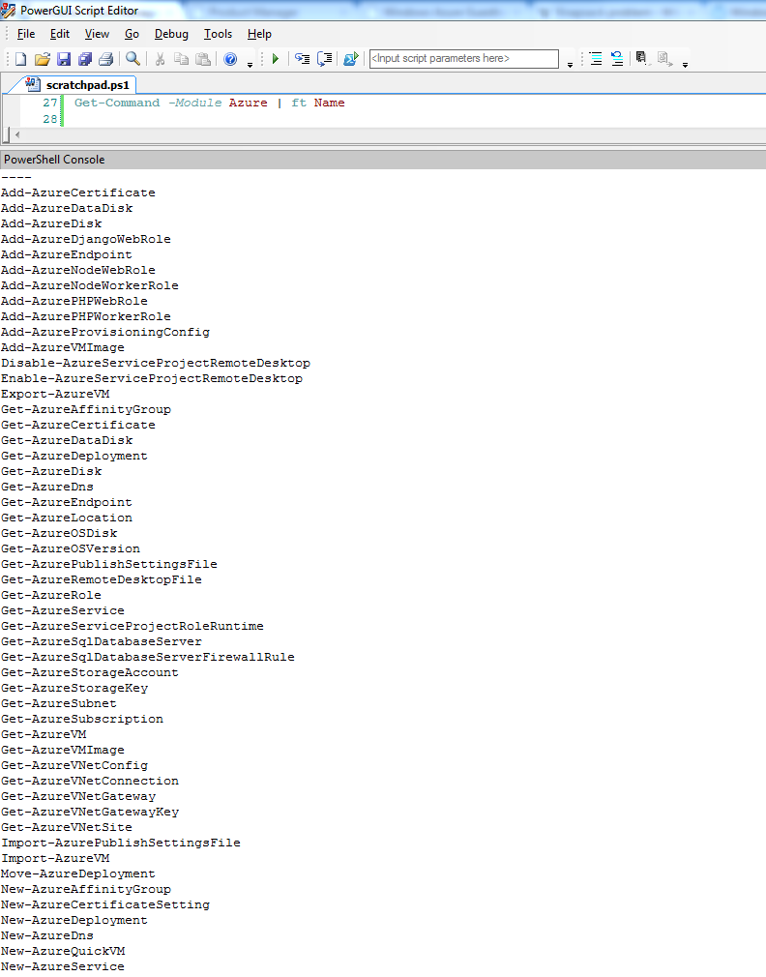
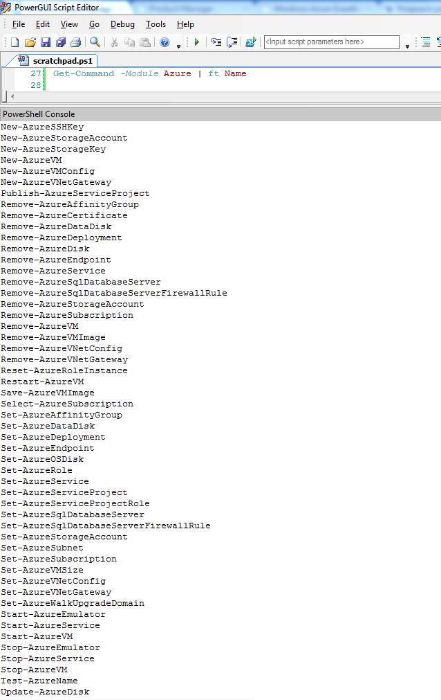
Service Management API
Provides programmatic access to platform functionality
Used to deploy, manage, and monitor applications
Powerful REST API, performed over SSL and mutually authenticated using X.509 certificates
May be accessed from within application running in Windows Azure, or directly over the Internet from any application

Slide 4
What can you do with PowerShell?
Remote Management
Manage SQL Databases, Configuration, Diagnostics, Deployments, and Azure assets (Affinity Groups, Storage Accounts, Keys, etc..)
Automation
Query, Manage and Configure Virtual Machines across multiple subscriptions, cloud services and storage accounts.
Provision Fully Configured Virtual Machines
Domain Joined
Storage and Networking Configured
Virtual Networking
Completely Configure VNETs from a Script

Slide 5
Getting started
Download and Install Windows Azure PowerShell http://go.microsoft.com/?linkid=9811175
Invoke Add-AzureAccount
Automatically configures Subscription ID, Certificate, Service Endpoint and Subscription Name
Multiple Subscription Support
Get-AzureSubscription | foreach {
Select-AzureSubscription $_.SubscriptionName
# Perform Management Operation Against Each Subscription
}

Slide 6
Virtual Machine Management
Quick VM Provisioning Mode
Supports VM Creation in a Single Cmdlet
Advanced Provisioning Configuration Mode
Provision With: Endpoints, Data Disks
Configure: Cache Settings for OS/Data Disks and Subnet Names
Create Multiple Pre-Defined VMs in a Batch
New-AzureVM -VMs $vm1, $vm2, $vm3

Slide 7
Setting the current storage account
Returns Storage Account
Get-AzureStorageAccount | Select StorageAccountName
Sets the Current Storage Account
Set-AzureSubscription 'somesub1' -CurrentStorageAccount 'mystorage‘
Cmdlets like New-AzureQuickVM will use this Account

Slide 8
Information needed to create a VM
Image Name
Get-AzureVMImage | select ImageName
Disk Name
Get-AzureDisk | select DiskName
Data Center Location
Get-AzureLocation

Slide 9
Simple VM creation
First Virtual Machine in a NEW Cloud Service (-Location specified)
New-AzureQuickVM -Windows -ServiceName $svc -Name $vm1 -ImageName $wimg -Location $location -Password $pwd
New Virtual Machine in an Existing Cloud Service(no -Location)
New-AzureQuickVM -Windows -ServiceName $svc -Name $vm2 -ImageName $wimg -Password $pwd
Creating a Linux Virtual Machine in an Existing Cloud Service
New-AzureQuickVM -Linux -ServiceName $svc -Name $vm3 -ImageName $limg -LinuxUser $lu -Password $pwd

Slide 10
Virtual machine discovery
Retrieve Cloud Services
Get-AzureService
Retrieve Virtual Machines for Service
Get-AzureVM -ServiceName $cloudSvcName
Retrieve Status for All VMs in Subsription
Get-AzureService | foreach {
$_ | Get-AzureVM | ft ServiceName, Name, InstanceStatus
}

Slide 11
Common settings
Name
The name of the Virtual Machine
AvailabilitySetName
The availability set (used for high availability)
InstanceSize
ExtraSmall, Small, Medium, Large, ExtraLarge

Slide 12
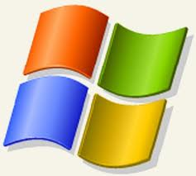

Provisioning options
Add-AzureProvisioningConfig
-Windows -Password $pwd
-WindowsDomain -Password $pwd
-Domain $dom, -JoinDomain $fqdn, -DomainUser $domUser
-DomainPassword $domPwd -MachineObjectOU $ou
-DisableAutomaticUpdates
-NoRDPEndpoint, -TimeZone, Certificates
Add-AzureProvisioningConfig
Linux
-LinuxUser $user -Password $pwd
-DisableSSH , -NoSSHEndpoint
-SSHKeyPairs, -SSHPublicKeys

Slide 13
Setting VM configuration
New-AzureVMConfig -Name $vm1 -InstanceSize Medium -ImageName $img |
Add-AzureProvisioningConfig -Windows -Password $pwd |
Add-AzureDataDisk -CreateNew -DiskLabel 'data' -DiskSizeInGB 10 -LUN 0 |
Add-AzureEndpoint -Name 'web' -PublicPort 80 -LocalPort 80 -Protocol tcp |
New-AzureVM -ServiceName $newSvc -Location $location

Slide 14
Virtual machine storage
Data Disks
Add/Remove data disks at boot or while running
Create blank or attach existing disks
Modify Cache Settings of OS Disk or Data Disk
Modifying OS Disk while running requires reboot

Slide 15
Data disk creation
New Virtual Machine Creation with Data Disk
New-AzureVMConfig -Name 'myvm1' -InstanceSize 'Small' -ImageName $img |
Add-AzureProvisioningConfig -Windows -Password $pwd |
Add-AzureDataDisk -CreateNew -DiskSizeInGB 10 -DiskLabel 'myddisk' -LUN 0 |
New-AzureVM -ServiceName $cloudSvcName
Add new Data Disk to existing Virtual Machine
Get-AzureVM -ServiceName 'myvm1' |
Add-AzureDataDisk -CreateNew -DiskSizeInGB 10 -DiskLabel 'myddisk' -LUN 1 |
Update-AzureVM

Slide 16
Disk and image repository
ОС Образы
Get-AzureVMImage # Return all
Get-AzureVMImage | Where { $_.Category -eq 'Microsoft' } # Return Microsoft
Get-AzureVMImage | Where { $_.Category -eq 'User' } # Return Custom
Get-AzureVMImage | Where { $_.Category -eq 'Partner' } # Return Partner Images
Get-AzureVMImage | Where { $_.OS -eq 'Windows' } # Return only Windows OS images
Remove-AzureVMImage -ImageName 'myimg' -DeleteVHD # Delete image and storage
Add-AzureVMImage -OS 'Windows' -ImageName 'MyWinImage' -MediaLocation 'http://storageaccount/vhds/winimage.vhd' # Add Existing VM Image from Storage
Microsoft, Partner and User
Диски
Get-AzureDisk # Return all
Get-AzureDisk | Where { $_.AttachedTo -eq $null } # Return all not attached to a VM
Get-AzureDisk | Where { $_.OS -eq $null } # Return only data disks
Get-AzureDisk | Where { $_.OS -eq 'Windows' } # Return only Windows OS disks
Remove-AzureDisk -DiskName 'mydisk' -DeleteVHD # Delete disk and storage
Add-AzureDisk -OS 'Windows' -DiskName 'MyWinDisk' -MediaLocation 'http://storageaccount/vhds/winosdisk.vhd‘ # Add Existing OS Disk from Storage
Add-AzureDisk -DiskName 'MyDataDisk' -MediaLocation 'http://storageaccount/vhds/datadisk.vhd‘
# Add Existing Data Disk from Storage
OS Disks or Data Disks

Slide 17
Customer Manager Architecture

Slide 18
Automating Customer Manager Application
1
Provision 2 frontend servers and 1 backend
Remote PowerShell to vms and configure its parameters: firewall rules, app pools, etc.
2
Compile and build CustomerManager. Deploy the package to frontend servers. Point frontend servers to SQL VM.
3
4
Run CustomerManager and observe results

Slide 19
Demo session
Demo

Slide 20
Migrating apps to the Cloud

Slide 21
Migration approaches
Build Virtual Machine in the Cloud
Lowers upload time and dependency risk
Requires upload and installation of application and data
Migrating an existing virtual machine
Application, configuration and data in an installed working state
Requires uploading a large amount of data and higher risk of drivers or other hardware dependencies on VM not available in the cloud

Slide 22

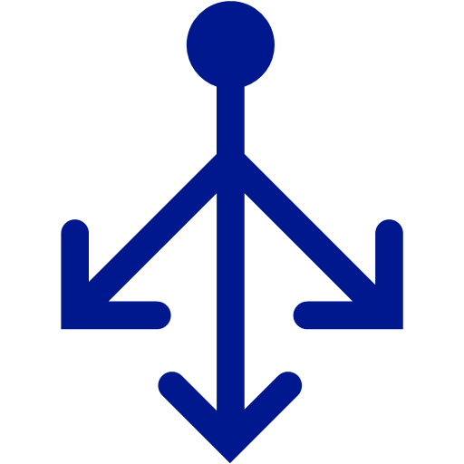


Migrating a Multi-VM Application
Cloud Service Acts as a Network Boundary
All vms in the same service can communicate directly.
Name resolution between VMs is automatic with Windows Azure provided DNS
Cloud Service
Name: bootcamp2015kh.cloudapp.net
Load Balancer
Public IP
VM Name: iisvm1
10.1.5.6
DIP
VM Name: iisvm2
10.1.5.7
DIP
DIP
VM Name: sqlvm1
10.1.5.8

Slide 23
Virtual machine migration
Windows Azure supports VHD file format
Other formats will have to be converted or migrated before upload
Upload existing VHDs using CSUpload.exe
Supports resuming failed transfers
Converting from dynamic to fixed disk on Upload
Efficient upload – does not send empty bytes
Things to do before uploading OS disk
Enable Remote Access

Slide 24

Migrating a simple virtual machine
Migration Steps
Cloud Service
Name: myapp.cloudapp.net
On Premises VM
Machine Name: APPSRV1
Memory: 8Gb
Cores: 4
Ports: 80/443 http/https
Upload VHDs
CSUpload or other tools
Virtual Machine
Role Name: appsrv1
4 cores
7 Gb RAM
Ports 80/443
2) Create VM
OS disk = APP-OS.vhd
3) Configure data disks
Data Disk 1 = App-Data.vhd
Data Disk 2 = App-Logs.vhd
Guest: C:\
Host: C:\VMs\APP-OS.vhd
Guest: C:\
Host: C:\VMs\APP-OS.vhd
Guest: D:\
Host: D:\VMs\APP-Data.vhd
4) Adjust app for drive letters
Guest: E:\
Host: E:\VMs\APP-Data.vhd
5) Add Endpoints (80/443)
Guest: E:\
Host: E:\VMs\APP-Logs.vhd
Guest: F:\
Host: F:\VMs\APP-Logs.vhd
Windows Azure Storage

Slide 25


Imaging VMs in the Cloud
Cloud
Base VHD
Capture VM saves customized image to your image library
Blob Storage
Boot VM
Customize VHD
Generalize VHD
Capture VM

Slide 26
Microsoft Azure Virtual Network
Persistent IP address requirements
Virtual machines deployed into a virtual network have an infinite DHCP lease
Hybrid On-Premises Cloud Apps
Requirement for connectivity between your datacenter and the public cloud
Connectivity between cloud services
Deploying Active Directory in the Cloud or connecting a PaaS to IaaS Service

